Slide 1
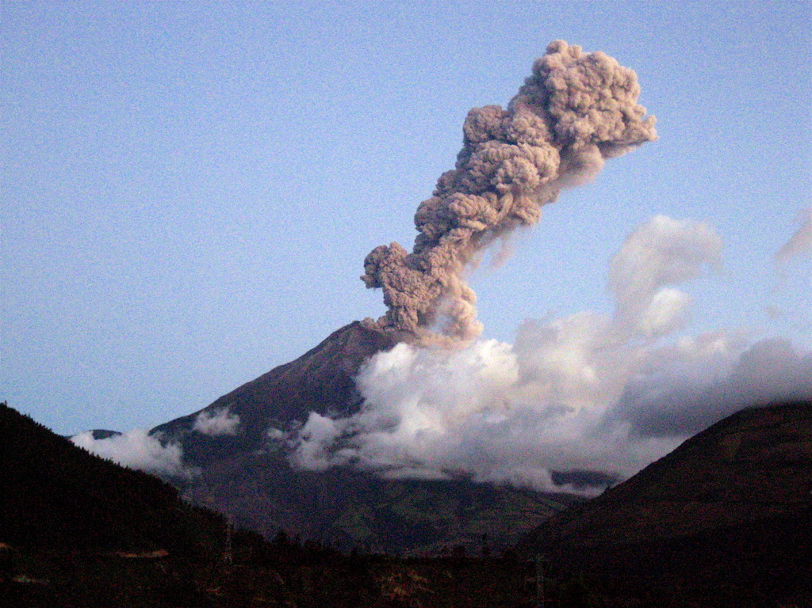
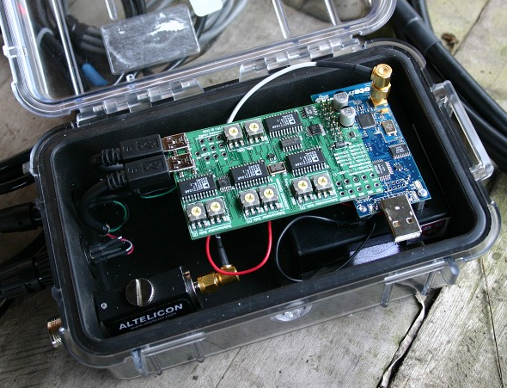
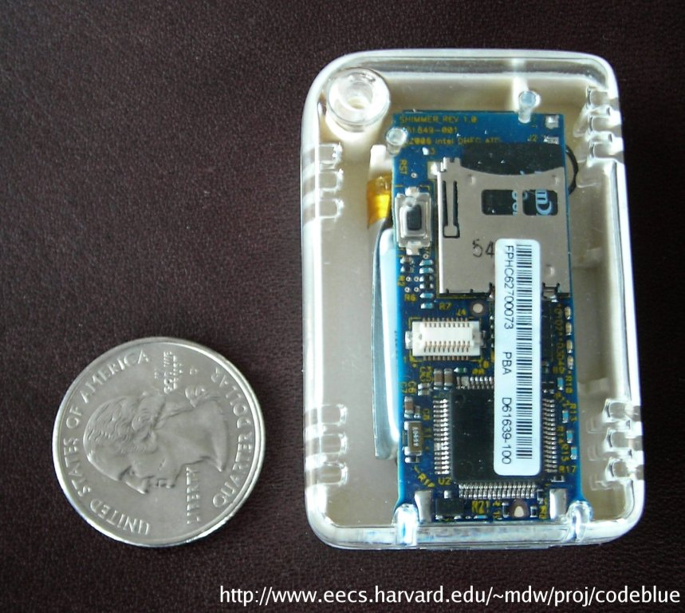
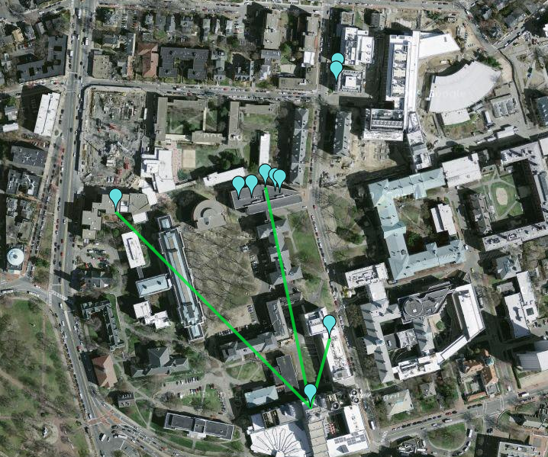

How to Program a Macroscope
Matt Welsh
Harvard University

Slide 2
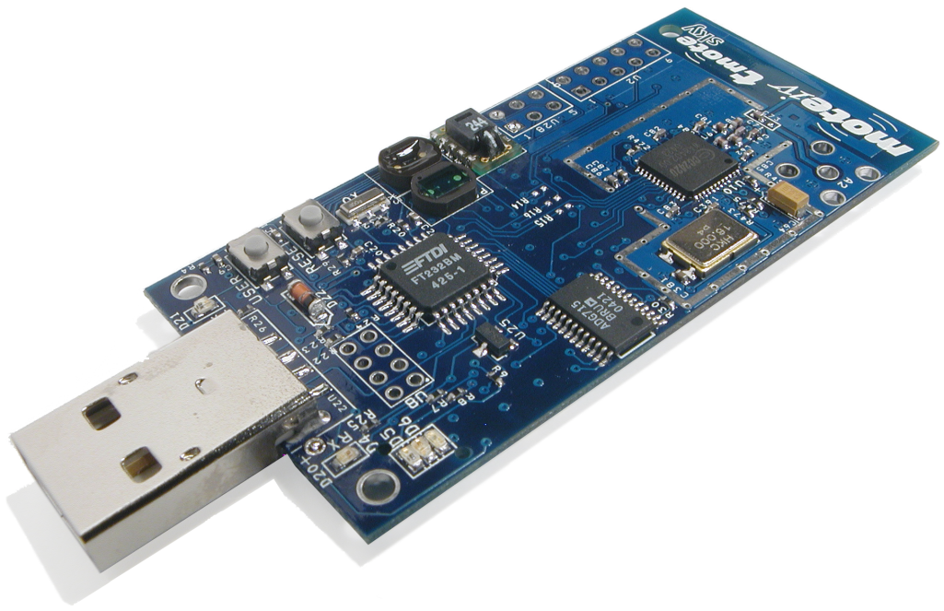
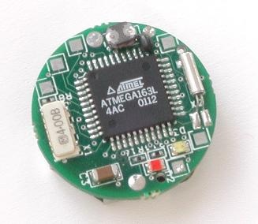
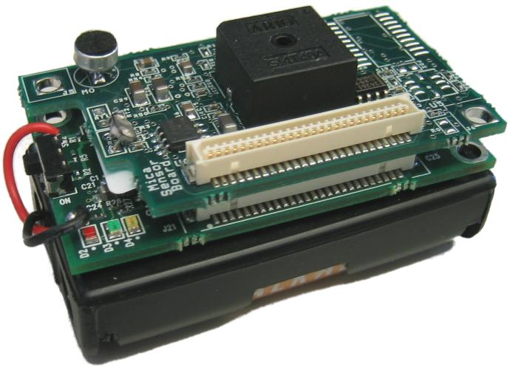
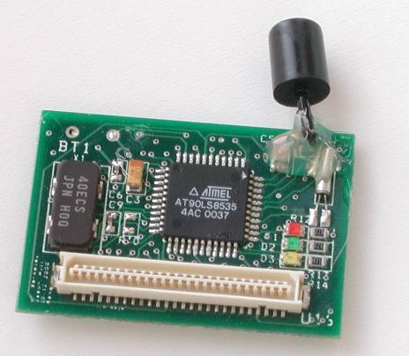
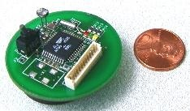
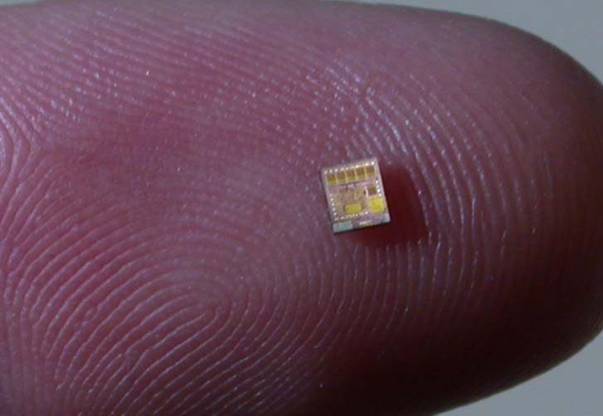
Sensor Networks: A New Computing Platform
SHIMMER
Embedded devices integrating a modest amount of computation, communication, and sensing
Typical “mote” hardware
8 MHz CPU, 10 KB RAM, 60 KB ROM
Low-power radio (IEEE 802.15.4 – 250 Kbps PHY rate)
Various sensors (e.g., light, temp, humidity)
Cost: Around $75
Designed for low power consumption:
70 mW active (CPU+radio); 6 uW sleep
Telos
WeC
Speck
Dot
Rene
MicaZ

Slide 3
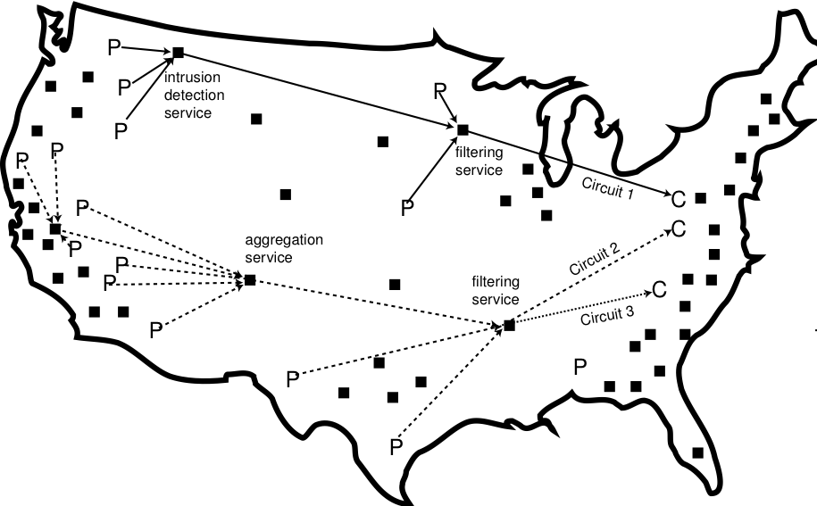
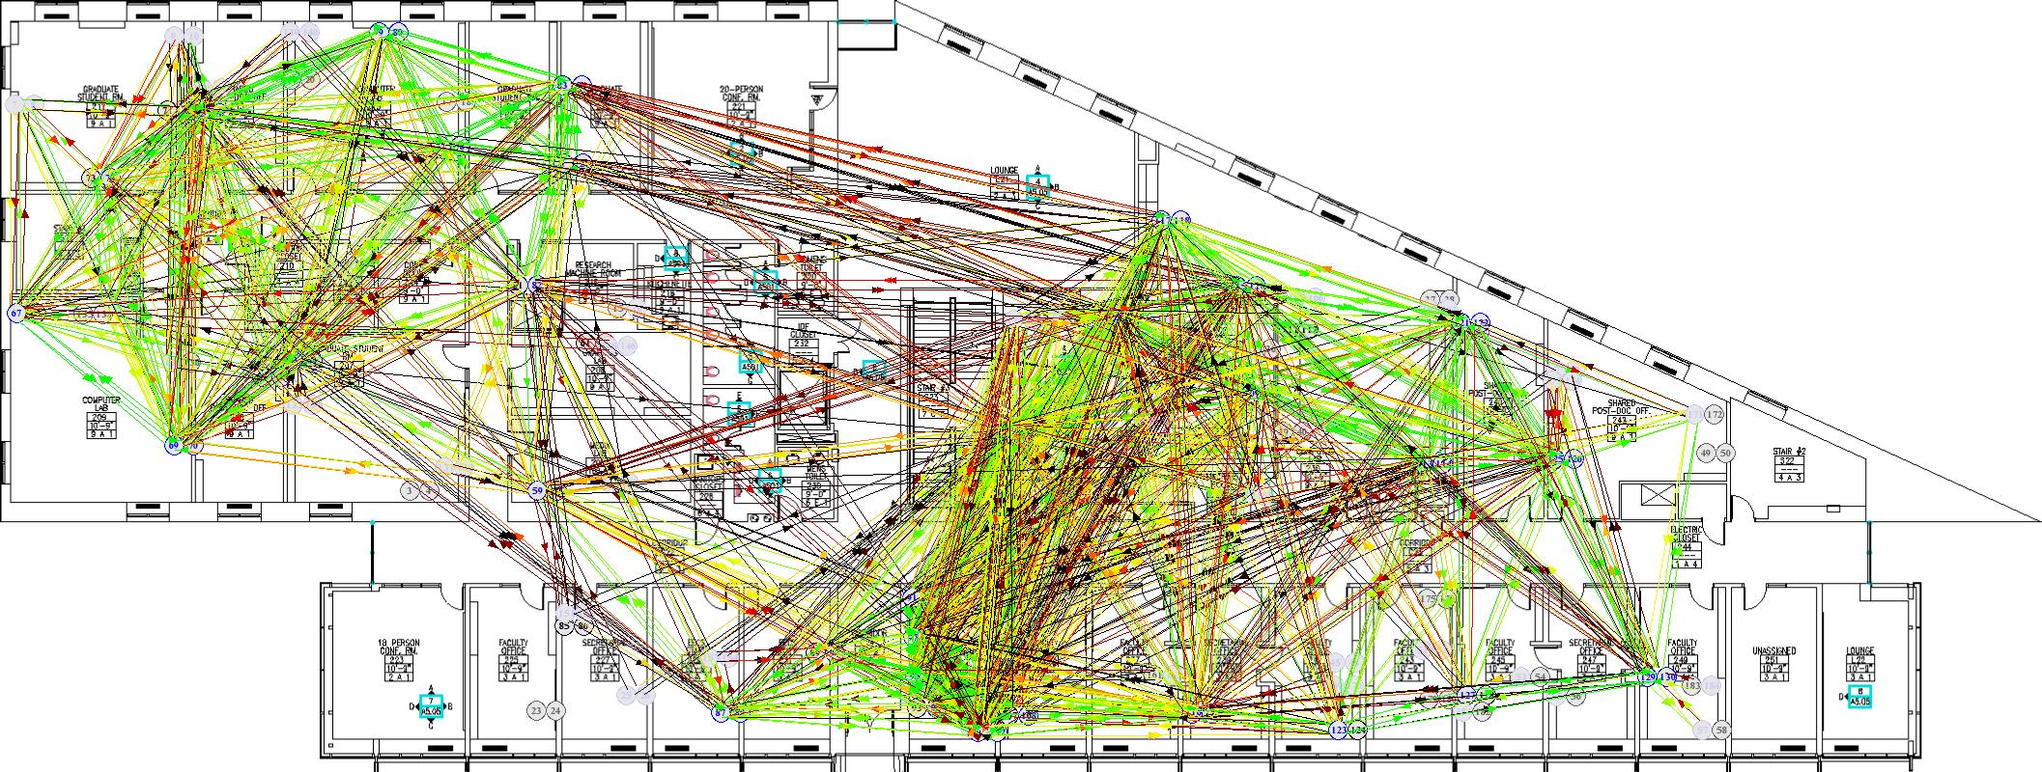
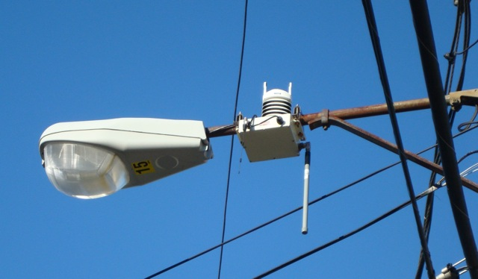
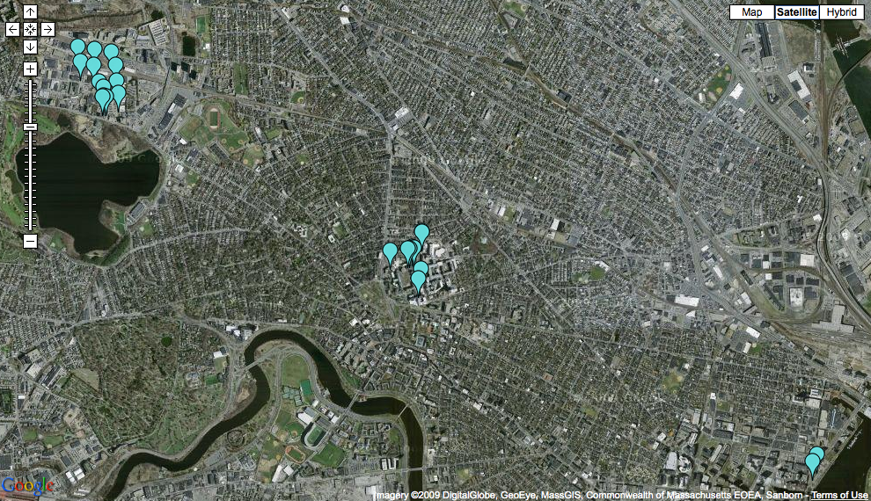
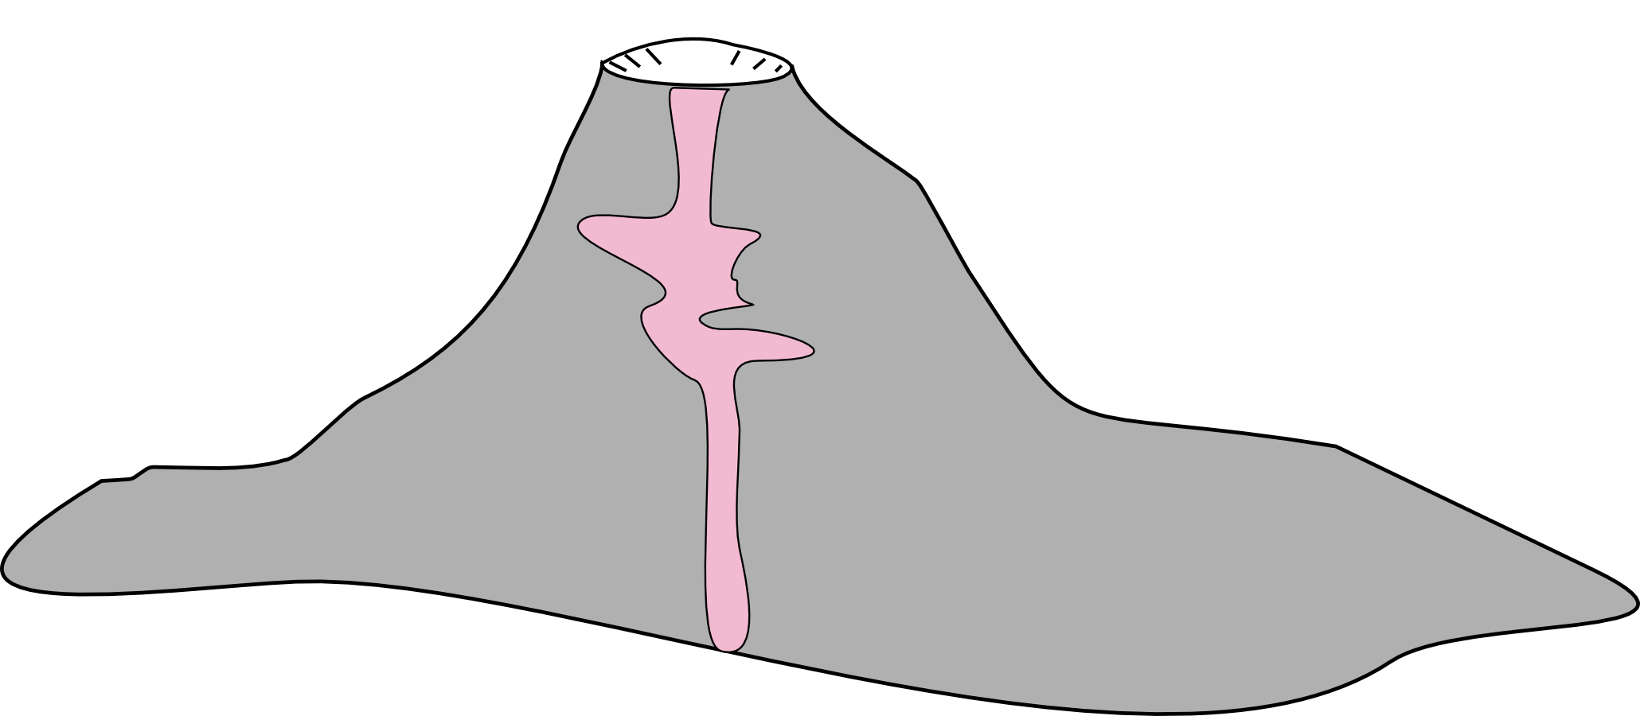
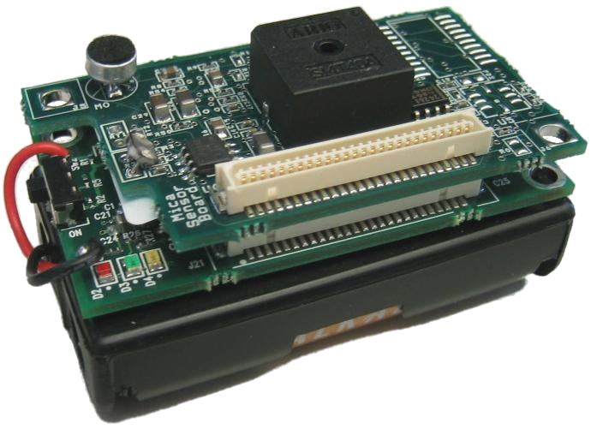

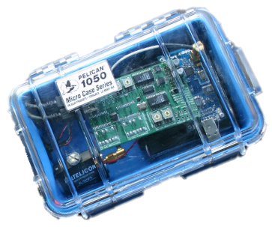
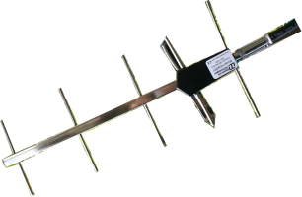

Applications at many scales…
Urban-scale environmental monitoring
Planet
Continental and global scale data collection and processing
Neuromotor disease rehabilitation
Volcano seismology
City
Volcano
Building
Body
Industrial, commercial, and residential environmental monitoring

Slide 4
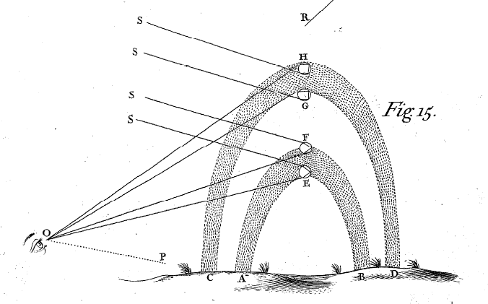
The Macroscope
For the first time, sensor networks allow us to:
1) Observe the world (environment, buildings, people, etc.) at very high spatial resolutions;
2) Make these observations continuously; and
3) Collect the observations in digital form.
Some have referred to this concept as a “macroscope” – a scientific instrument that observes entire systems.
After Joël de Rosnay, Le Macroscope. Vers une vision globale, 1975

Slide 5
Key Research Questions

Slide 6
Our Approach

Slide 7
Talk Outline
Two application vignettes.
Resource Aware Programming:
Make resources first class in the programming model.
Macroprogramming:
Program the network, rather than the individual device.
Wrap-up and conclusions.

Slide 8
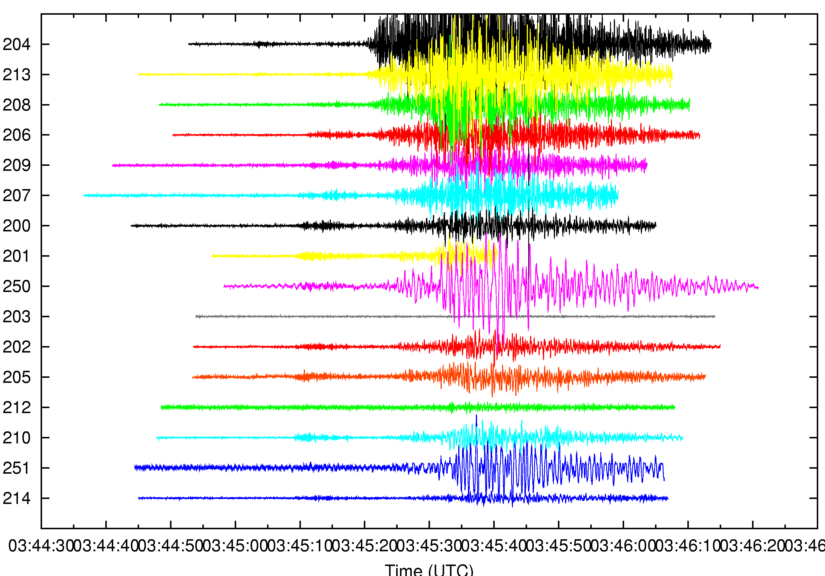
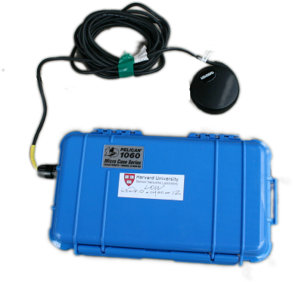


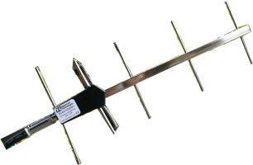
Application Vignette: Wireless Sensors for Volcanic Monitoring
Nodes continuously monitor seismic and acoustic signals,
sampling at 100 Hz.
1) Earthquake or eruption occurs
2) Nodes detect seismic event
3) Each node sends event report
to base station
4) 60 sec of seismic/acoustic data
downloaded from each node
GPS receiver
for time sync
Base station
at observatory
FreeWave
radio modem

Slide 9
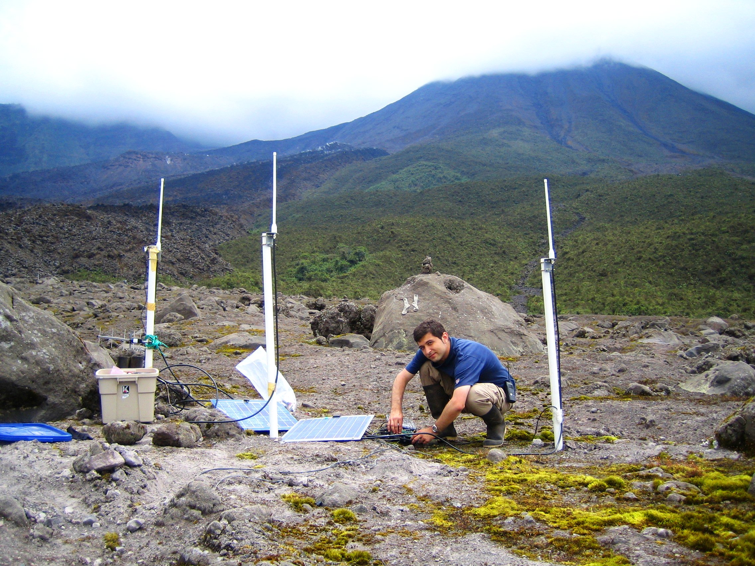
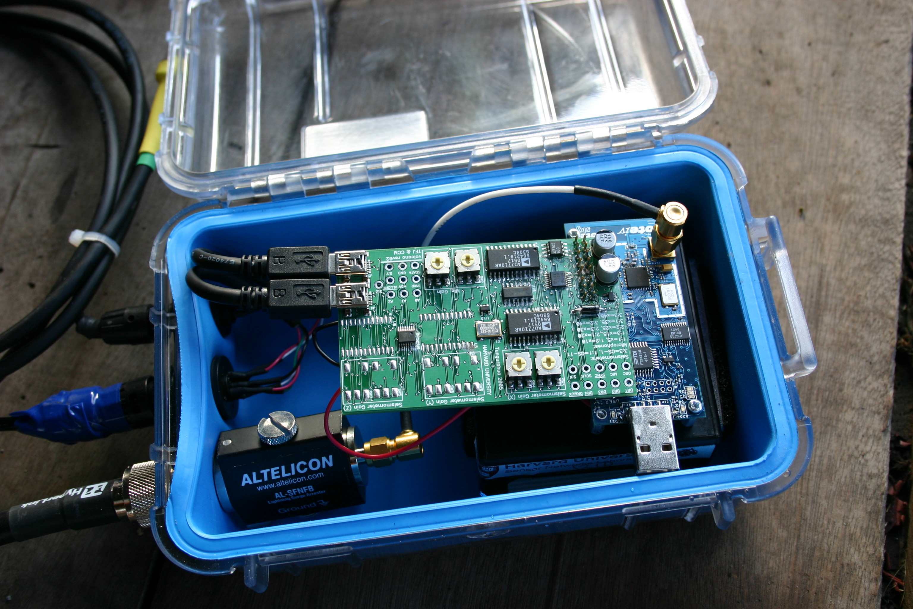
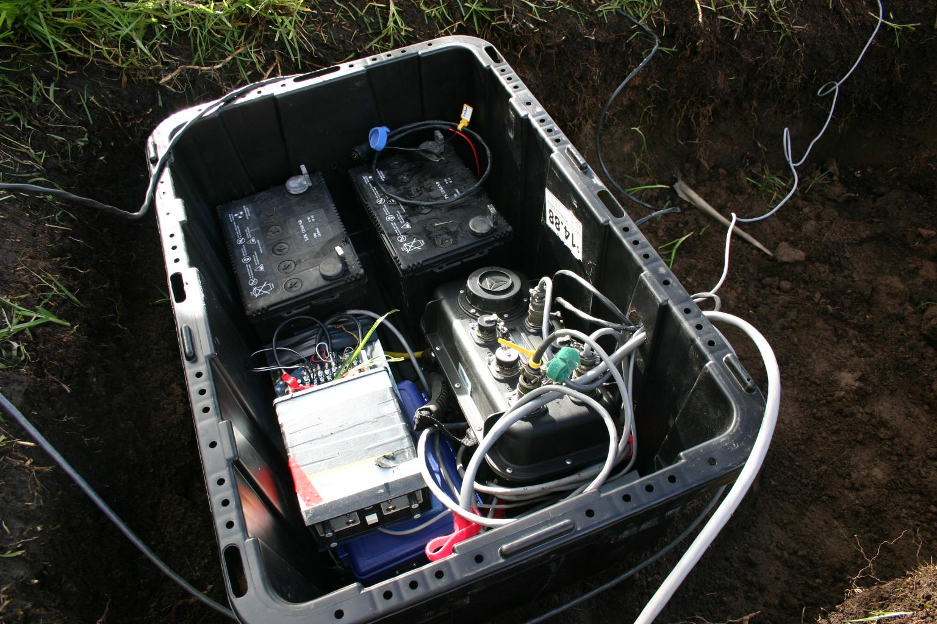
Reventador Volcano, Ecuador, August 2006
with Johnson (NMT) and Lees (UNC) [OSDI’06, J. Volc. Geo. Res.’06]
Four-channel
sensor node
Trusty grad student
Radio modem
GPS receiver
Solar panels for charging
car battery (used by
FreeWave and GPS only)‏

Slide 10
Parkinson’s Disease, stroke, and epilepsy monitoring with P. Bonato, Spaulding Rehabilitation Hospital [SenSys’09, IEEE Trans. Inf. Technol. Biomed. 2009]
High-fidelity monitoring of limb motion
Triaxial accelerometer, triaxial gyroscope
6 channels per node, 100 Hz per channel
Full resolution signal exceeds radio bandwidth
Store raw data to flash (2 GB MicroSD)‏
Nodes perform local feature extraction
RMS, jerk, dominant frequency, other features...
Computationally intensive processing
Requires communication (e.g., time sync, and signal correlation across nodes)‏
Offline classification to map features to clinical scores
Motion sensors
SHIMMER mote

Slide 11
Challenge #1: Resources are extremely limited
Sensor nodes are severely resource constrained
8 MHz CPU
10 KB of memory
~100 Kbps of radio link bandwidth (best case)
200 mAh – 2000 mAh batteries
Demands new approach to software design
Careful management of resources at the node level
Adaptation to changing load and resource availability
Coordination of resource allocation across the network
Our mantra: Resource Aware Programming
Make resources a first class primitive in the programming model.

Slide 12
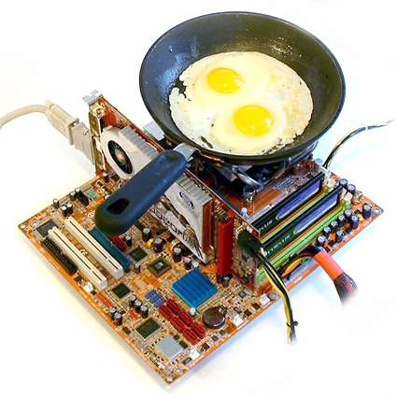
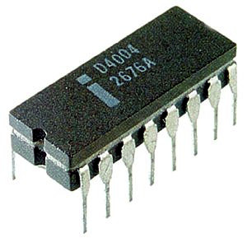
What about Moore’s Law?
Transistors/Performance/ Power (log scale)
Time

Slide 13

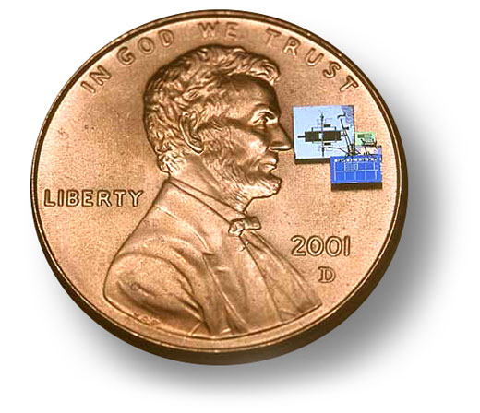
What about Moore’s Law?
Power/ Size/ Cost
Time

Slide 14
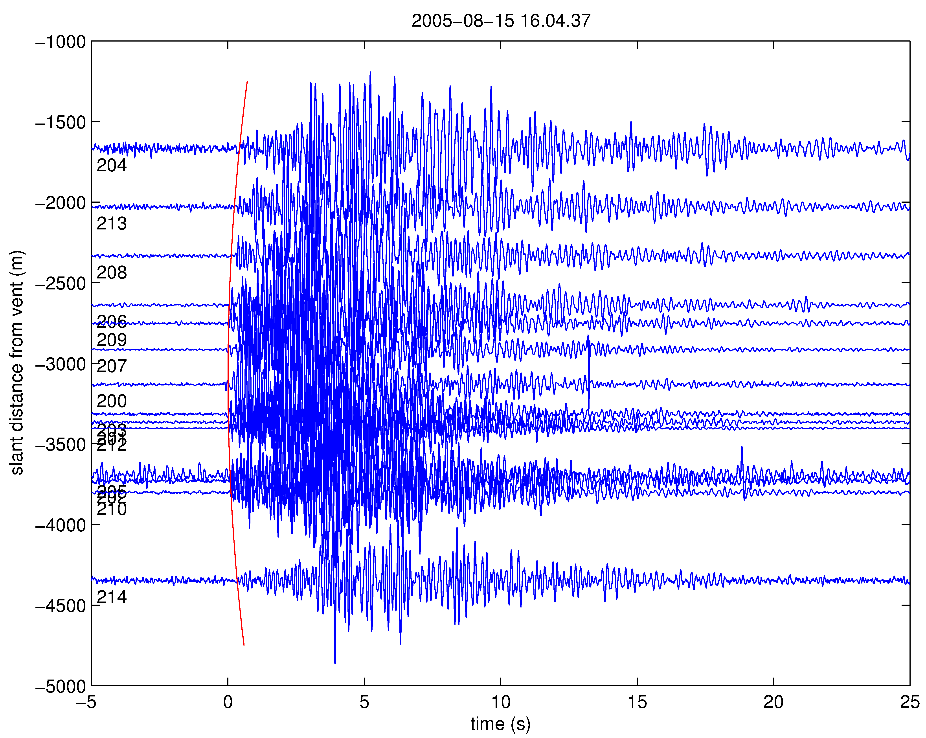
Challenge #2: Need for high data fidelity
Sensor networks must yield scientifically meaningful data.
Gives rise to many unique challenges:
Sensor calibration
Timing precision
Reasoning about the impact of failures
Establishing ground truth
… all coupled with the aforementioned resource limitations.
Many of these challenges are not obvious at first blush.

Slide 15
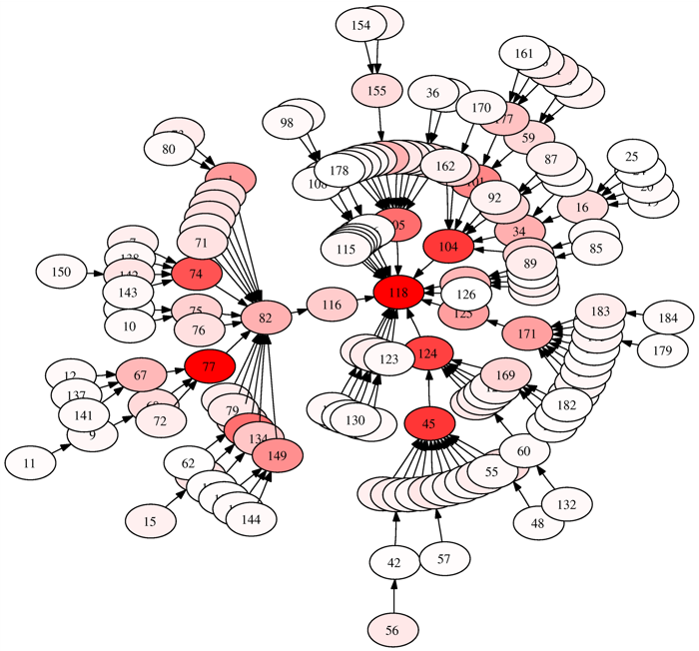
Challenge #3: Programming Complex Network Behavior
Current approaches focus on programming individual sensor nodes
Example: NesC [PLDI’03] – Component oriented variant of C for embedded systems
Extremely low level:
Radio messaging
Sensor acquisition
Hardware duty cycling
Memory management
Difficult to reason about complex interactions between nodes.

Slide 16
Talk Outline
Two application vignettes.
Resource Aware Programming:
Make resources first class in the programming model.
Macroprogramming:
Program the network, rather than the individual device.
Wrap-up and conclusions.

Slide 17
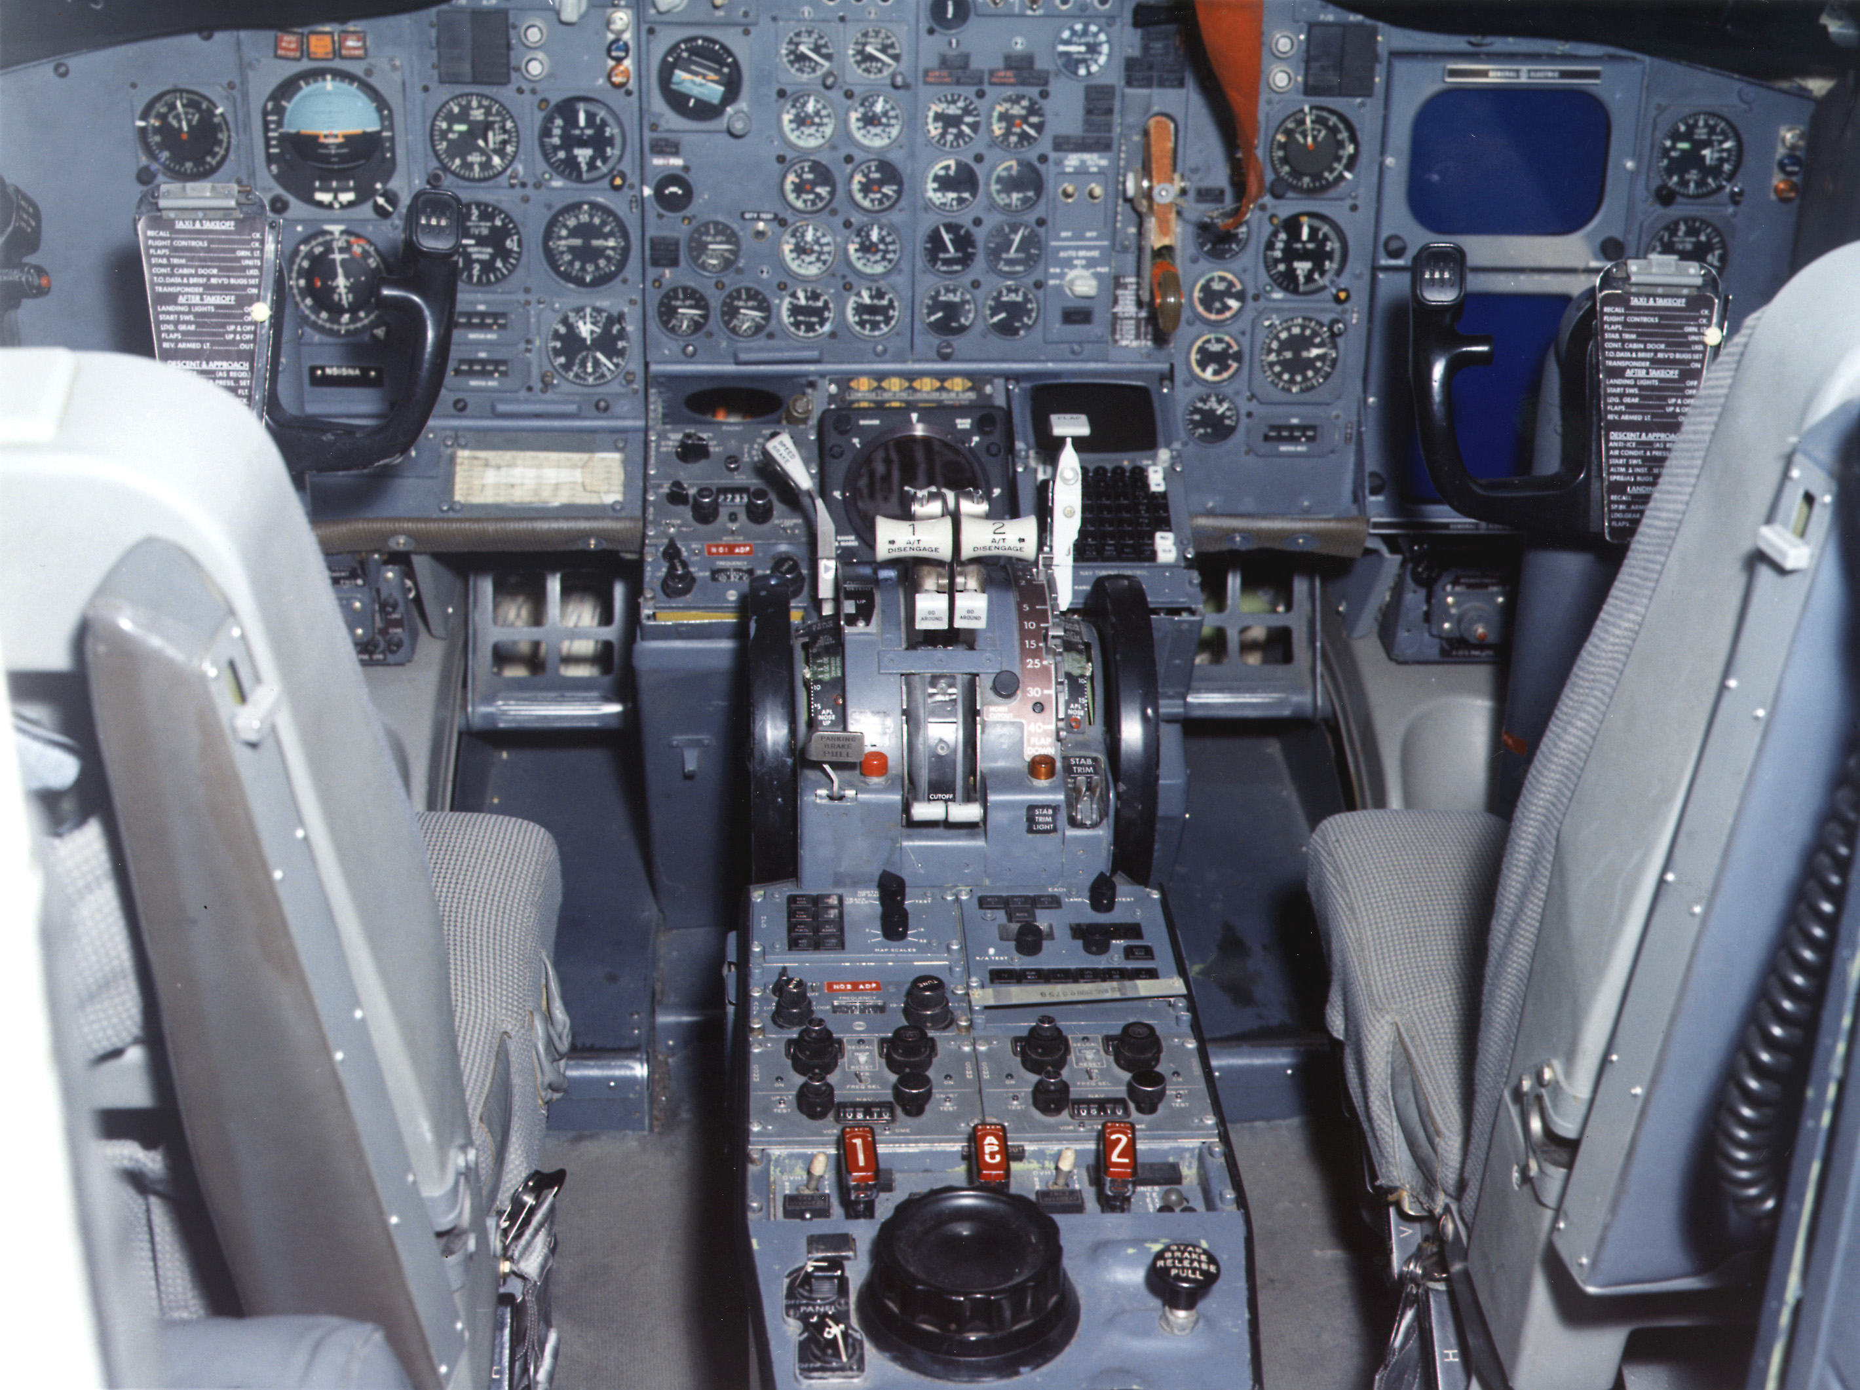
Resource tuning in sensor networks
Sampling rate
Interval
Many control knobs scattered throughout
App Control
Heartbeats
Data fidelity
ETX threshold
Drip
CTP
FTSP
Refresh rate
Refresh rate
Update interval
Active messages
Multiple components with complex wiring
Framing
Activity threshold
Data processing
Processing rate
Queue
Buffer mgmt
Log
Queue size
Pool size
Buffer size
LPL MAC
Filter
Queue
LPL interval
Notch frequency
Queue size
Radio driver
ADC driver
Flash driver
LED driver
Timer
Tx power
DMA threshold
Write timeout
CC2420
ADC
Flash
LEDs
Clock

Slide 18
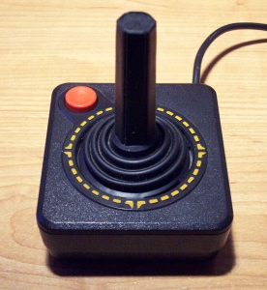
What we really want

Slide 19
Our Approach: The Pixie Operating System [SenSys’08, HotEmNets’08]
Pixie is a new operating system for sensor networks that supports:
Resources as a first-class programming primitive
Key abstractions: resource tickets and brokers
Pixie is intended to make it easy to write adaptive applications
With such limited sensor node resources, application must contend with varying resource conditions!
Fundamental challenge:
How to enable resource awareness without placing undue burden on the programmer?

Slide 20
Sample Application: Motion Analysis
Each stage performs computation or I/O
Decimate
RMS
Sampling
Activity Filter
Radio Link
Peak Amplitude
Do some computation
Drop
Autocorrellation
FlashStorage
request(700mJ, 10sec)
Ticket
request(2 packets, 5 sec)
Ticket
<Energy, 700mJ, 10sec>
Pixie Energy Allocator
Bandwidth Allocator
Energy Estimator
Bandwidth Estimator

Slide 21

Resource tickets in Pixie
Tickets are the key abstraction for resource management
Provide feedback to applications on resource availability
Decouple allocation from use
Great deal of expressive power
Making strict guarantees about resource reservations is difficult:
System cannot promise that a given resource will be available when needed.
e.g., radio bandwidth can fluctuate considerably due to ambient conditions, cross traffic, and node mobility.
Pixie tickets are revokable, even before the expiry time
Trade off efficiency for ease of use.

Slide 22
Resource Brokers
Resource tickets are intended to be low-level and fine-grained
Very flexible and powerful, but sometimes difficult to use
To simplify app design, we introduce resource brokers
Brokers request and manage resource tickets on behalf of the application
Each broker implements some policy and provides a high-level API to the app
Tickets provide mechanism; brokers implement policy.

Slide 23
Example: Bandwidth Broker
Decimate
(20 pps)
<nominal rate>
RMS
(6 pps)
Sampling
Activity Filter
Bandwidth
Broker
Radio Link
6pps
4pps
2pps
Peak Amplitude
(4 pps)
<nominal rate>
Autocorrellation
(2 pps)
FlashStorage
Request(32 packets, 1 sec)
12pps
Bandwidth Allocator
Bandwidth Estimator
12 pps

Slide 24
Evaluation: Bandwidth Adaptation in Motion Analysis
Goal: Adapt type and quantity of data transmitted by each node as link quality varies
Don’t want to transmit data that won’t get to the base station.
Uses Pixie’s bandwidth broker
Multiple data types with associated cost and app-assigned value
Estimate available link bandwidth
Assign bandwidth tickets to maximize value subject to bandwidth limit
Type | Bandwidth | Value
Raw samples | 20 pps | 100
RMS | 6 pps | 20
Peak Amp. | 4 pps | 10
Autocorrelation | 2 pps | 5

Slide 25
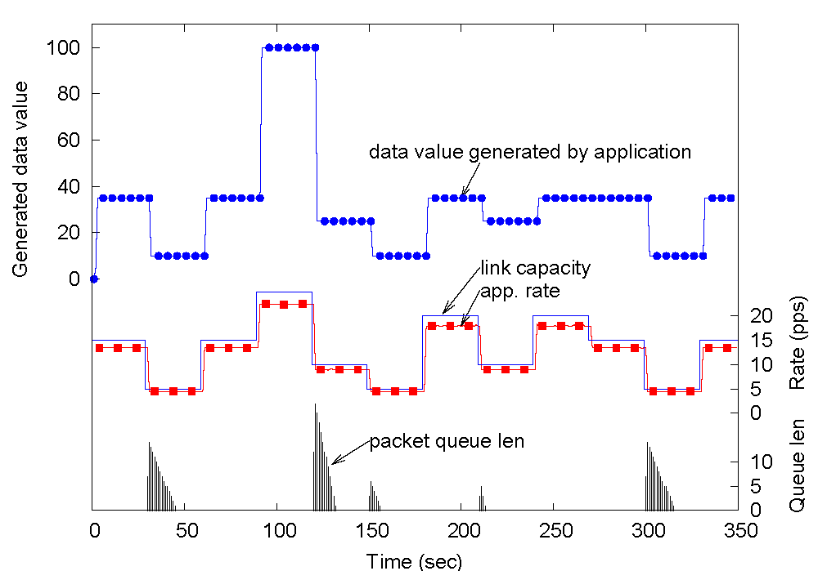
Experiment: Bandwidth Adaptation
Raw samples
Type | Bandwidth | Value
Raw samples | 20 pps | 100
RMS | 6 pps | 20
Peak Amp. | 4 pps | 10
Autocorrelation | 2 pps | 5
Combination of features
Bandwidth estimator is very accurate
Spikes in Tx queue when bandwidth drops

Slide 26
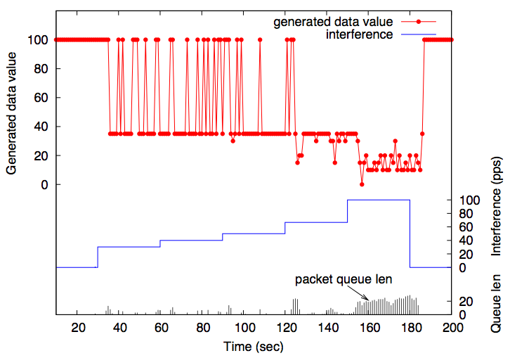
Adaptation to radio channel interference
Gracefully degraded data value
Increasing packet congestion

Slide 27
Network-Wide Resource Management
Large sensor networks constrained in two important ways:
Bandwidth: Reliable data transfer is very slow.
Energy availability: Even if bandwidth were plentiful, can’t run radios all the time.
To optimize data fidelity, need to carefully manage resources across the network as a whole.
Let’s focus on one key problem: Reliable signal collection

Slide 28
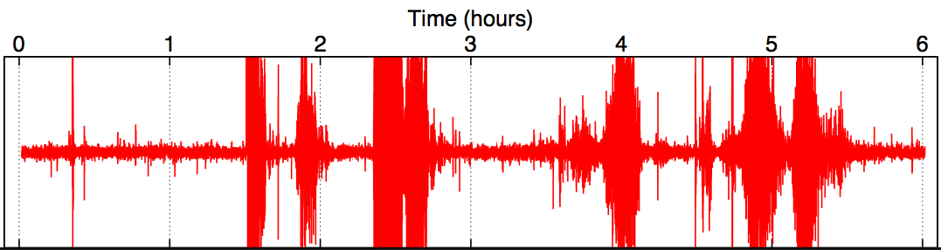
Observation: Data Differs in Value
interesting data

Slide 29
Observation: Data Differs in Acquisition Cost
Six hops:
600 bytes/sec
25142 mJ
One hop:
1000 bytes/sec
2230 mJ

Slide 30
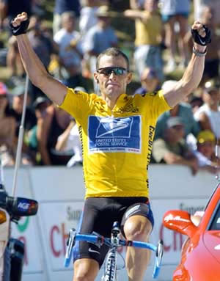
Our Approach: Lance [SenSys’08]
System for priority driven allocation of bandwidth and storage resources within a sensor network
Goal: Optimize data quality subject to energy and bandwidth constraints
Lance decouples mechanisms for resource allocation from app-specific policies
Can target many optimization metrics
e.g., fairness, spatial/temporal data distribution, etc.

Slide 31
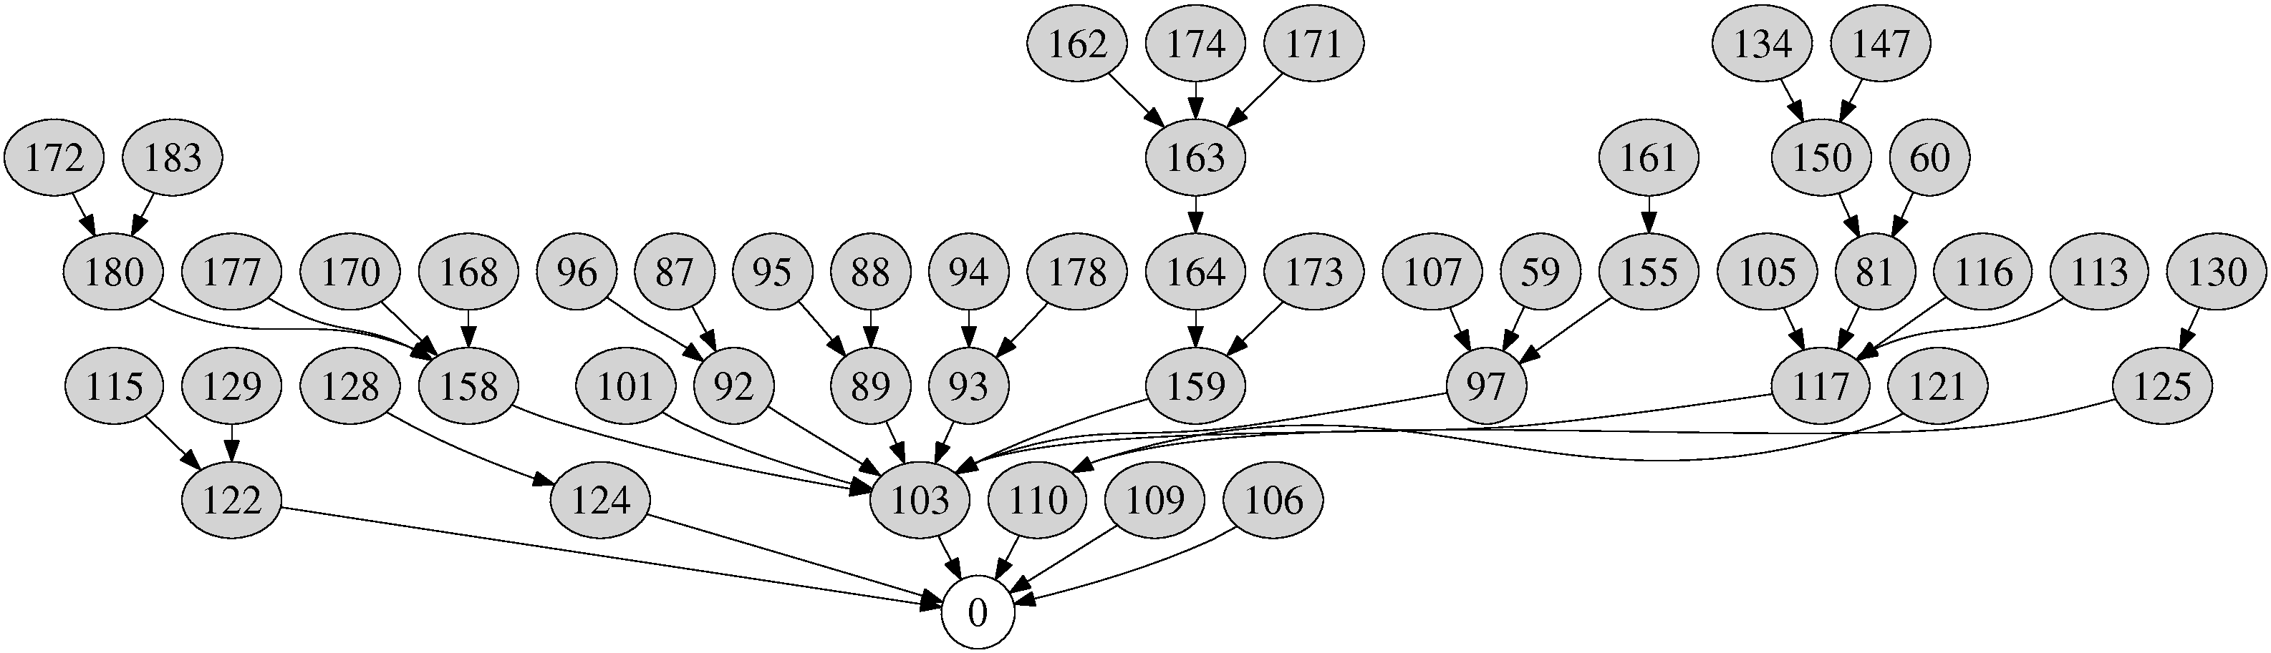

Lance Design
Application Data Units (ADUs)
Compute value
Concise ADU summmaries
Battery levels
Cost model
Topology
Download
highest-scoring raw data
Download
ADU scores
Score
Base station

Slide 32
Optimization Goal
U = Set of all possible ADUs
E = Vector of energy capacity of each node
c(u), v(u) = cost and value for each ADU u
The optimal set u_{o} is the set of ADUs maximizing
∑ v(u_{o}) subject to ∑ c(u_{o}) ≤ E
Offline Solution: Multidimensional Knapsack Problem
But we need an online, greedy approximation.

Slide 33
Scoring function comparison 10-node linear chain
Data value retrieved (% of available)
Biased towards nodes near sink
Closely matches offline optimal solution
Downloads same amount of data from all nodes

Slide 34
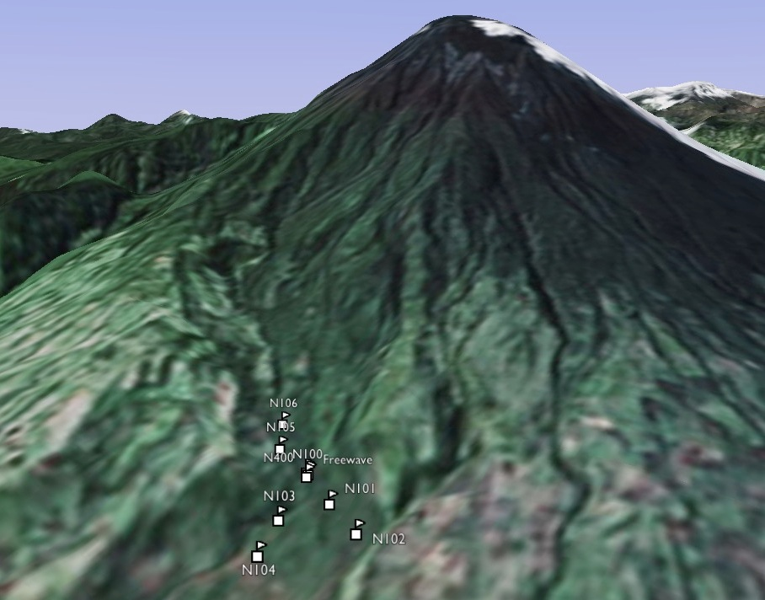
Tungurahua Volcano Deployment
Volcán Tungurahua field deployment,
August 2007
Tungurahua summit
8 km to observatory

Slide 35
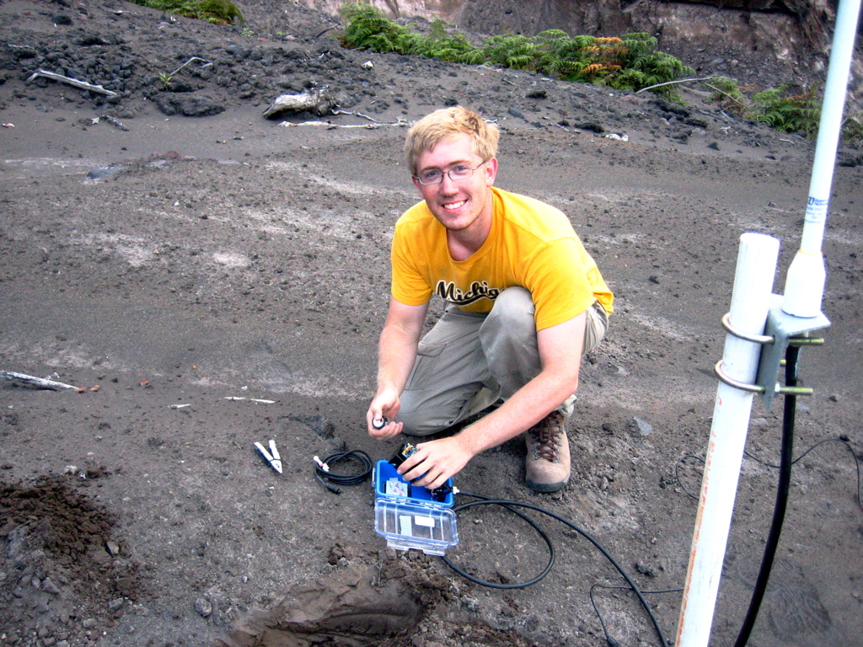

Slide 36
Deployment Results
Deployed 8 sensor nodes for a total of 71 hours
Lance used to manage storage and bandwidth
Experimented with different prioritization functions and policy modules
Successfully downloaded 1232 ADUs (77 MB of data)‏
308 downloads failed due to timeouts: success rate 80%
Total storage summaries span 11012 ADUs (688 MB of data)‏
Lance downloaded 11% of the data acquired by the network
Lance downloaded 99.5% of the optimal dataset

Slide 37
Talk Outline
Two application vignettes.
Resource Aware Programming:
Make resources first class in the programming model.
Macroprogramming:
Program the network, rather than the individual device.
Wrap-up and conclusions.

Slide 38
Macroprogramming
I hope I’ve convinced you that sensor net programming is hard.
Can we do better?
Key idea: Program the network as a whole.
Compile down automatically to node-level programs.
Key challenges:
What are the appropriate programming abstractions?
How do we retain good resource efficiency?
How to automate the compilation process?

Slide 39
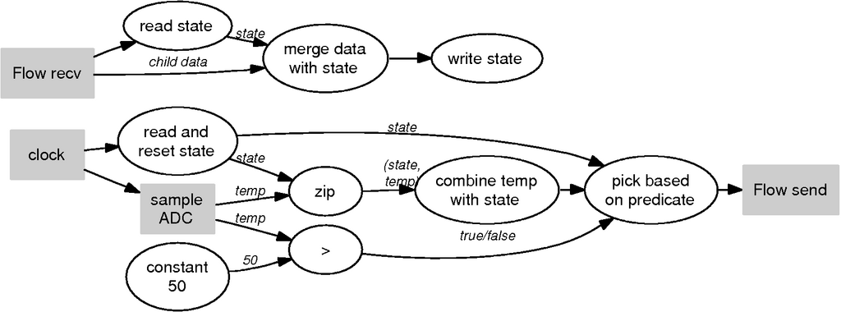
Flask: Dataflow Macroprogramming [ICFP’08]
Synthesize sensor net programs from high-level dataflow
Example: Compiling an SQL query
SELECT AVERAGE(temp) WHERE temp > 50 PERIOD 10 s

Slide 40
Regiment: A Stream-Oriented Macroprogramming Language [IPSN’07, IPSN’05, DMSN’04]
Node state represented as a time-varying stream
Map function
Form Region
f
f
g
mean
f
f
max
f
f
g
mean
f
f
Fold Region streams into single
stream
Filter
time

Slide 41
Regiment Example: Chemical plume “Hotspot” Detection
Sensors above concentration threshold
let hot_spot : concentration position =
let cs = rfilter (λ c . c >= THRESH) concentration
vote = rmap (λ _ . 1) cs
neighbor_votes = gossip 1 vote
tally = rfold (+) 0 neighbor_votes
pt = zip position tally
above = rfilter (λ (p,c) . c > COUNT) pt
in
map (λ (p,c) . p) above
let conc_stream = rmap (λ n . get_conc(n)) world in
let pos_stream = rmap (λ n . get_pos(n)) world in
hot_spot (conc_stream pos_stream)
Aggregate votes from neighbors
Only report sensors with enough voting neighbors
Return position of selected nodes
Read chemical concentration and position
Entire sensor network
Compare to thousands of lines of C code.
Notes:
Add callouts to walk thru program.
Talk about number of lines of code saved.

Slide 42
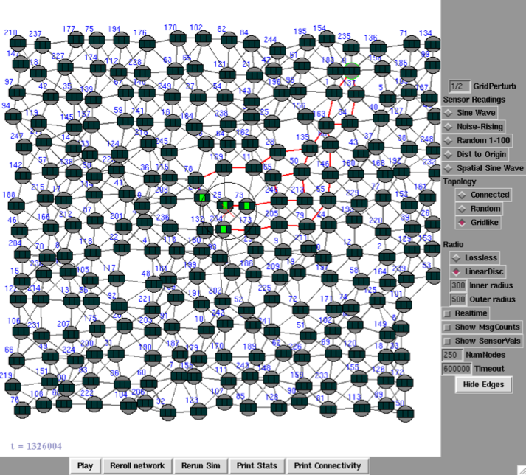
Regiment Plume Detection at Work
Messages routed
to base station
Chemical
plume detected

Slide 43
Overview of Other Projects
Novel programming models
Abstract Regions: Neighborhood communication model [NSDI’04, HotNets’03]
SORA: Decentralized resource allocation based on machine learning [NSDI’07]
Planetary-scale data collection and processing
COBRA: RSS and blog search engine [NSDI’06]
Hourglass and SBONs: P2P overlay for stream processing [ICDE’06, NetDB’05, IPTPS’05]
Testbeds and tools
MoteLab: 184 nodes in Maxwell Dworkin [SPOTS’04]
CitySense: Urban-scale open sensor testbed [IEEE HST’08]
TOSSIM: Accurate, energy-aware sensor network simulation [SenSys’03, SenSys’04]
New architectures for wireless LANs
Dyson: A programmable, evolvable wireless LAN [HotNets’08]

Slide 44
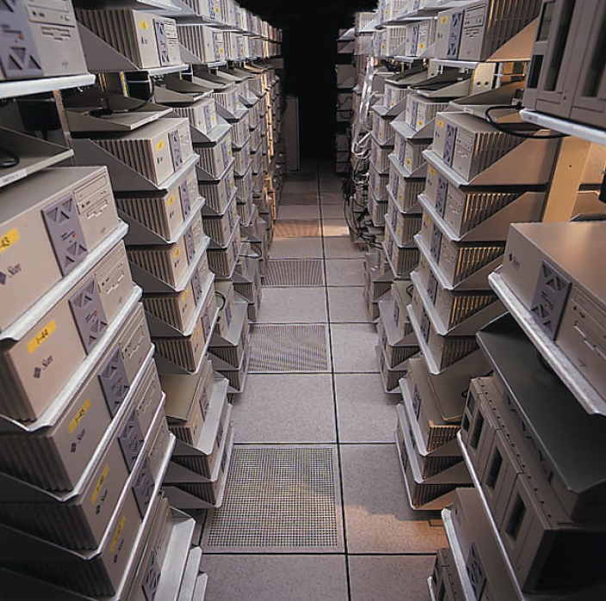
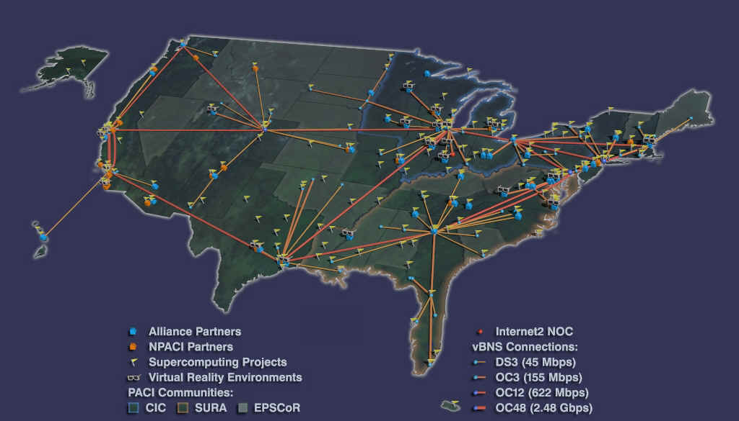

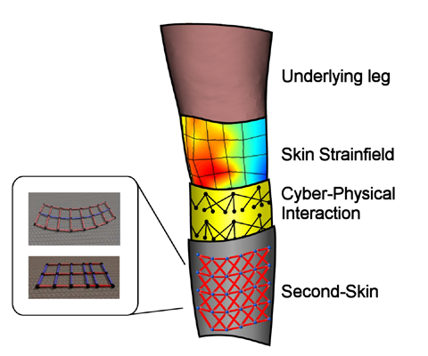
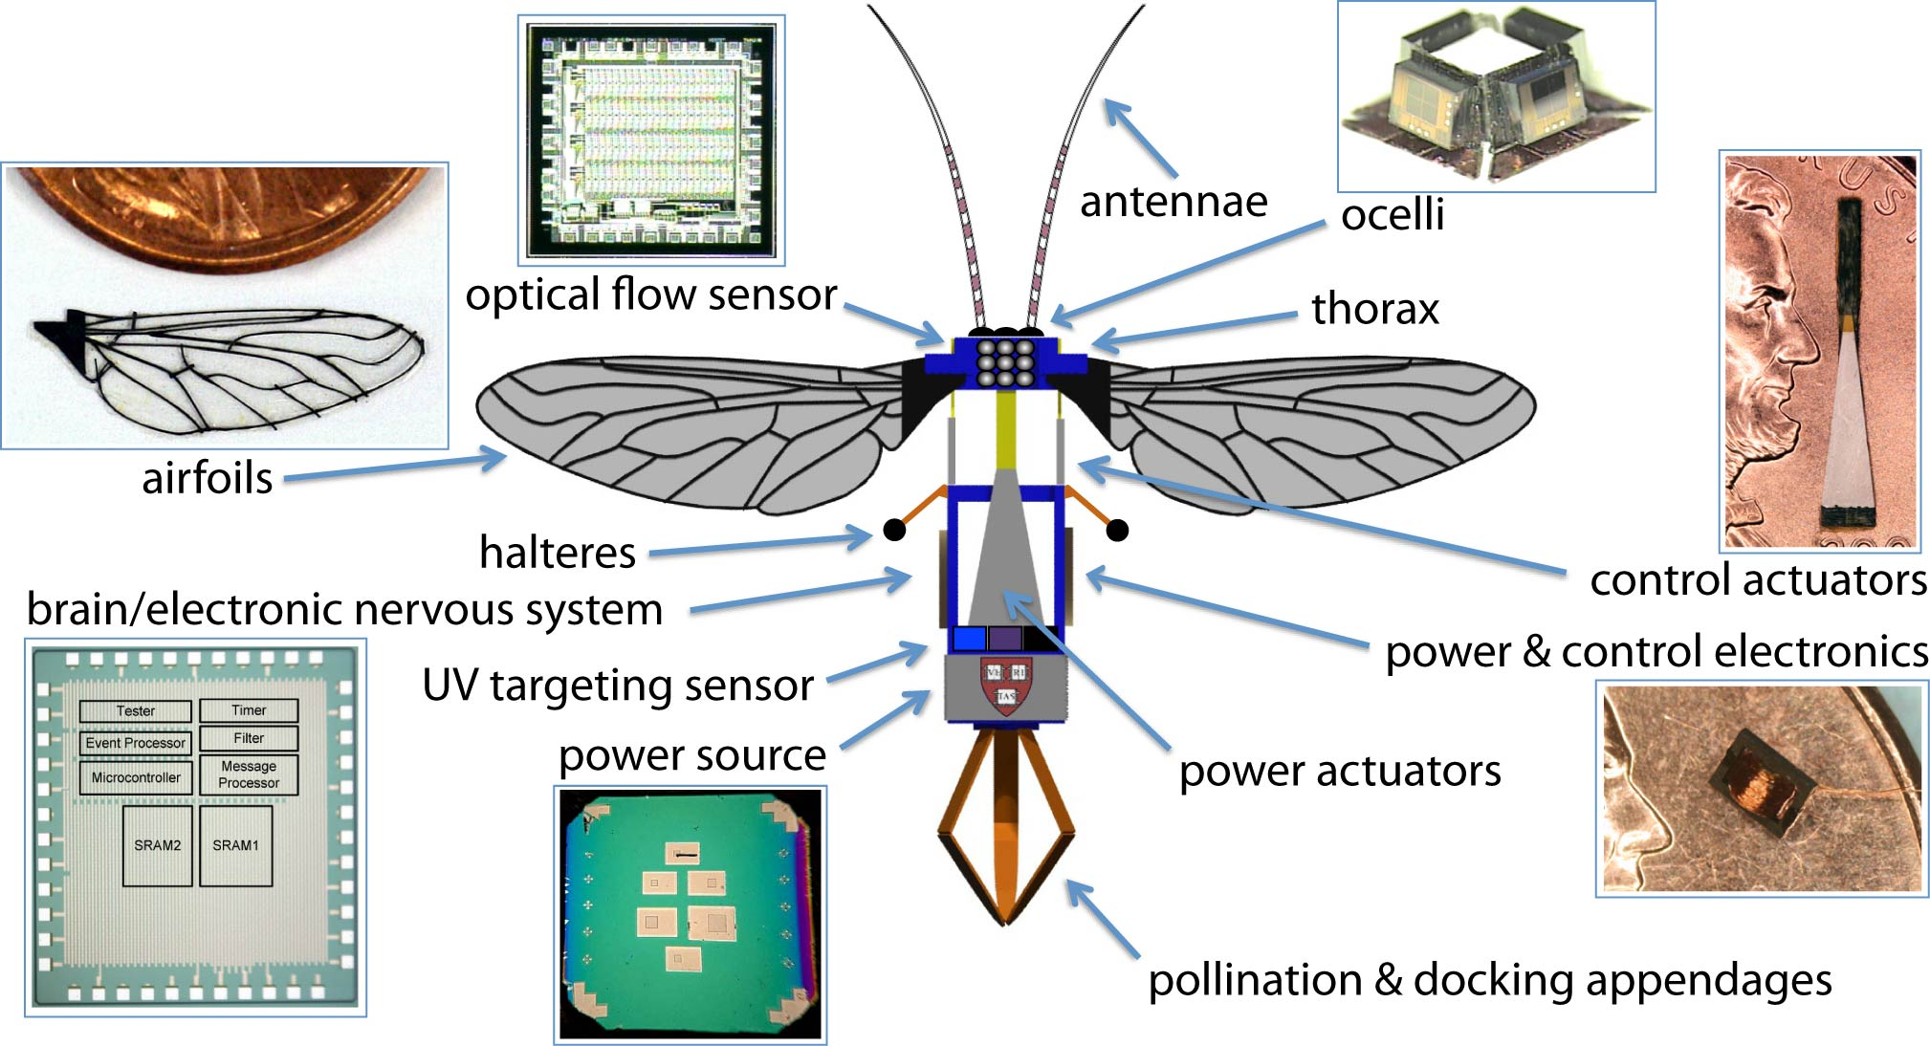
Implications – Beyond Sensor Networks

Slide 45
Conclusions
Sensor networks have tremendous potential to impact scientific discovery.
They give rise to several unique programming challenges:
Achieving good resource efficiency at the node and network level
Building up complex network behaviors
Our work has focused on OS, programming model, and language techniques to tackle these challenges.
Real-world scientific applications are the key driver behind this research agenda.

Slide 46
Acknowledgments
Current and former grad students and postdocs: Geoffrey Challen, Dr. Bor-rong Chen, Breanne Duncan, Dr. Konrad Lorincz, Geoffrey Mainland, Rohan Murty, Dr. Peter Pietzuch, Ian Rose, Atanu Roy Chowdhury, Victor Shnayder, Jason Waterman, Dr. Alexander Wissner-Gross
Current and former undergrads: Peter Bailis, Keith Berkoben, Stephen Dawson-Haggerty, Dr. Thaddeus Fulford-Jones, Jason Gao, Yang Gao, Mervin John, Qicheng Ma, Josh Montana, Nambi Nallasamy, Chris Newman, Samir Paul, Geoffrey Peterson, Danny Popper, Peter Salas, Chris Simmons, Daniel Steinbrook, Hassan Sultan, Aditya Sunderam, Patrick Swieskowski, Matt Tierney, Yara Wehbe, Andrew Wong, Mumu Xu, Dimah Yanovsky, Chelsea Zhang
Collaborators: Dr. Jeffrey Johnson (NMT), Dr. Jonathan Lees (UNC), Dr. Paolo Bonato (Spaulding), Dr. Steve Moulton (Denver Children’s), Tia Gao (Stanford), Dr. Jitu Padhye (Microsoft), Dr. Ranveer Chandra (Microsoft), Josh Bers (BBN), Dr. Ryan Newton (MIT), Glenn Holloway, Dr. Majid Ezzati (HSPH), Dr. Jack Spengler (HSPH), Dr. David Brooks, Dr. Greg Morrisett, Dr. Radhika Nagpal, Dr. David Parkes, Dr. Mema Roussopoulos, Dr. Margo Seltzer, Dr. Gu-Yeon Wei
Special Thanks: Gioia Sweetland, Joanne Bourgeois

Slide 47
fin

Slide 48
Related Work
Resource management primitives in sensor networks
Large amount of work in energy reduction: MAC protocols, routing, sensor duty cycling
ICEM, SNACK: Enable cross-component energy reduction
iCount, Quanto: Energy metering support
Programming model support for resource management
Eon, Levels: Tune energy consumption according to set policy
We provide same functionality through Pixie resource brokers
TinyDB: Lifetime-targeted queries
Mobile systems
Odyssey: Framework allowing applications to adapt to energy, bandwidth, and CPU
ECOsystem: Tune OS scheduling policy for battery lifetime targets
Puppeteer: Adaptation to bandwidth variation

Slide 49
Intelligent Instrumentation
Sensor networks are not just passive instruments!
We can push processing into the network.
Processing can happen at many levels:
On individual sensor nodes.
At aggregation points within the network.
At the base station or gateway.
Sensor networks fundamentally change the notion of “scientific observation” from a passive process to an active one.
This has a deep impact on many aspects of science.

Slide 50
Resource Estimation
Storage and memory are straightforward
Allocators track total flash/memory consumption
Bandwidth: Radio link estimates packet transmission delay
Measure total time for packet transmission plus ARQ (if used)
Invert transmission delay to estimate instantaneous bandwidth
Maintain separate estimate for each neighbor
Currently assumes delay is independent of packet size

Slide 51
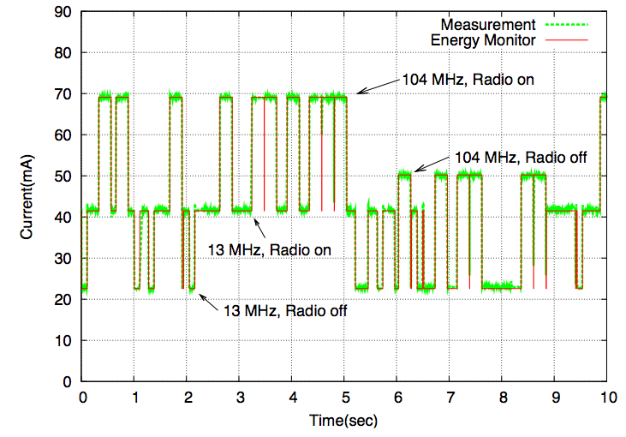
Software energy metering
Energy estimation performed in software
Tracks state of each hardware device (CPU, radio, flash, sensors) in real time
Accurate empirical model of hardware energy consumption (about 2-3% error)
Low overhead, no hardware support required.

Slide 52
Other Energy Brokers
Energy-aware switch
Sends data down one or more downstream paths based on energy availability
Mimics policy used by Eon [Sorber et al., Sensys 2007]
Expensive
operation
Data source
Energy switch
Moderate
operation
tickets
Cheap
operation
Default energy
broker
tickets
Energy Allocator
Energy Estimator

Slide 53
Other Energy Brokers
Energy-aware filter
Selectively drops data to meet energy target
Effectively controls scheduling and duty-cycling of downstream stages
Data source
Energy filter
Downstream
stages
…
tickets
Drop data
Default energy
broker
tickets
Energy Allocator
Energy Estimator

Slide 54
Example: Pixie Energy Broker
C
Energy debt
Conservative policy
Nominal energy schedule
Battery
capacity
Surplus
Reduce ticket allocations
ρ = C/LTT
Increase ticket allocations
time
LTT
Lifetime target

Slide 55

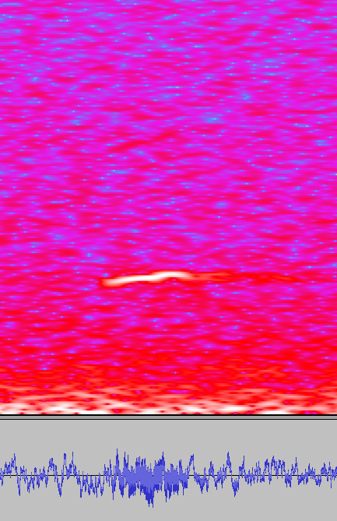
Evaluation: Acoustic Target Detection
Detect acoustic signature of target (marmot call) in acoustic signal, subject to variable noise.
[Girod et al. SenSys’06]
Three detection algorithms with increasing energy cost and accuracy
Goal: Maximize accuracy subject to battery lifetime target
High energy cost, very accurate
FFT detector
24 kHz acoustic
sampling
Drop if quiet
Energy switch
High-pass detector
Transmit detection
Threshold detector
Low energy cost, many false positives

Slide 56
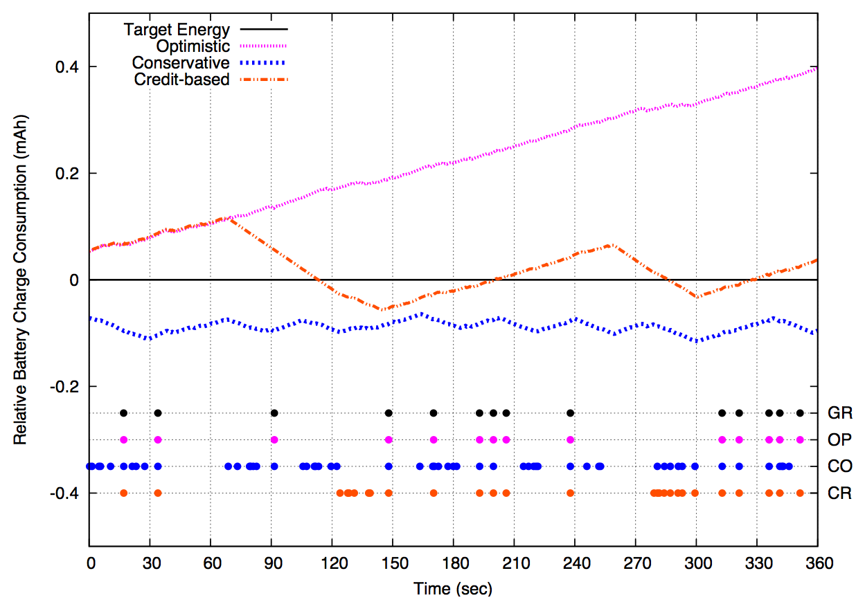
Energy adaptivity: Varying policies 40-day lifetime target
Optimistic policy:
Does not meet schedule…
Credit-based policy: Incurs limited energy debt
Debt payback: Threshold
Normalized to target energy schedule
Conservative policy:
Maintains schedule
Adequate energy: FFT
Dots represent target detections (including false positives)
…But is 100% accurate
Lots of false positives
Much more accurate
Ground truth
Optimistic
Ground truth
Conservative
Credit-based

Slide 57
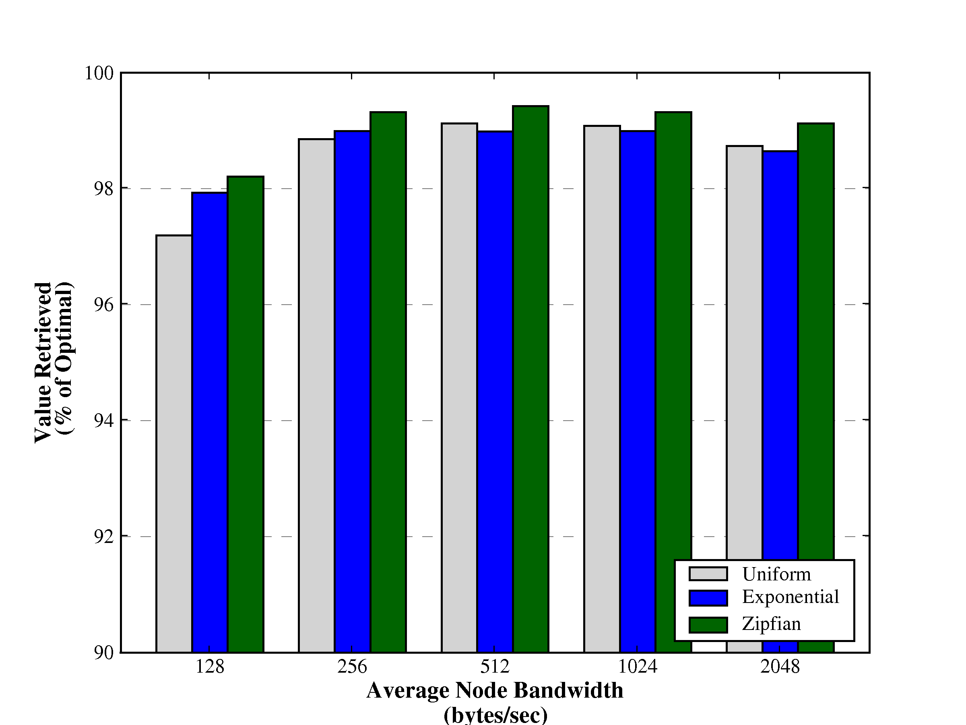
Varying Data Value Distribution
Above 96% in all cases

Slide 58
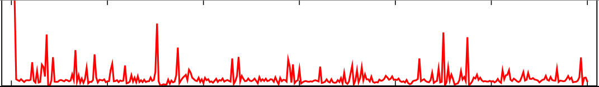
Defining Data Value
Assumption: nodes compute initial value for each ADU.
This determination is inherently app-specific
Raw signal
Short-term
average
divided by
long-term
average

Slide 59
Lance Policy Modules
User-supplied functions to inspect, filter, or modify raw ADU priorities at the base station.
Composed into a linear chain:
Take stream of ADU priorities as input, emit (possibly modified) priorities as output
Can maintain internal state
Must run efficiently (i.e., keep up with stream of ADU priorities from the network).
remove
noise
normalize
filter
<threshold
storage
summaries
download
priority

Slide 60
Example Policy Modules
Priority thresholding
filter: Drop ADU if value below threshold
Noise removal and calibration
adjust: adjust raw value by adding or subtracting fixed offset
debias: normalize data values across nodes
Priority dilation
timespread: assign high ADU values to ADUs adjacent in time
spacespread: assign high ADU values to ADUs sampled by different nodes
Cost weighting
costweight: scale ADU value by cost to download

Slide 61
Example: Correlated Event Detection
correlated policy module W(k,δ)
counts number of ADUs within a time window δ with a nonzero value
if at least k ADUs match, retain ADUs in the window
otherwise, drop this set of ADUs
Network-wide earthquake detection in Lance:
Policy implemented at the base station, rather than on motes.
Easy to modify behavior of network just by changing policy modules.
filter
(threshold)
correlated
(k,δ)
spacespread

Slide 62

Results under varying lifetime target 25-node tree, Zipf value distribution
Cost bottleneck achieves > 95% optimality across a wide range of target lifetimes

Slide 63

RSAM prioritization: DC bias
RSAM values exhibited large DC bias across nodes.
Lance only downloaded data from 1 or 2 nodes!

Slide 64

The fix: Debiasing policy module
Median debiasing filter run at base station normalizes RSAM values

Slide 65
Programming Benefits
Dataflow programming model maps well onto application structure
Similar to Eon, Tenet, WaveScope, and Flask
Tickets offer a great deal of flexibility and power
Fine-grained feedback and control of resource usage at all levels
Brokers decouple resource management policies from mechanisms
Enables composable resource adaptations
Resource-awareness is pervasive in the programming model
Not “off to the side”
Annoying at first, but makes sense when you get used to programming in this way
Exposes resource dependencies, rather than relying on hidden magic knobs

Slide 66

MoteLab Testbed Experiments 50 node tree topology, Zipf value distribution
Lance closely matches optimal behavior
Node ID
Total

Slide 67
Some Region Primitives
everywhere : α stream → α region
gossip : int → α stream → α region
rmap : (α → β) exp → α region → β region
rfilter : (α → bool) exp → α region → α region
rfold : (α *β → β) exp * β exp → α region → β stream
rfunnel : α region → α stream

Slide 68

Future Directions: Peloton
What about coordinated resource management within the network?
Example: Group of nodes detect an event, elect leader to collect signals, process data, deliver results to the base station.
Nodes need to share information on resource availability, coordinate resource allocation decisions, and represent cross-node allocations
Peloton – A Distributed OS for resource-aware programming
Decentralizes resource management within the network
Extend Pixie’s abstractions to span allocations on multiple nodes.
[HotOS 2009]

Slide 69


Future Directions: RoboBees
NSF Expeditions in Computing
My group: Swarm OS for distributed resource management and programming models

